Slide 1

A PROJECT I FINAL DEFENSE ON PHONE BOOK SYSTEM
Project Members
Asha Silwal(TU Regd. No : 6-2-253-2-2019)
Puja Thapa(TU Regd. No : 6-2-253-8-2019)
Submitted To:
Department of Computer Application
2079-06-04

Slide 2
INTRODUCTION
PHONE BOOK SYSTEM is web-based application
Provide SQL-based solution to record contacts
Digital system to record contacts
Store, Add, Update, Load, Search and Delete contacts
Develop project under spiral model
Take data and manage in database

Slide 3
PROBLEM STATEMENT
Hard phonebook is less efficient
Leads to loss or misplace of data
Difficult to edit, search, delete data
Lack of security and privacy
Need more human resources
Time consuming than digital-phonebook

Slide 4
OBJECTIVES
To simplify the task
To reduce the paper-based work
To make data accessing faster

Slide 5
FEATURES
Add: Enter new entry of data
Arrange: Arrange contacts alphabetically
Update: Edit data if needed any changes
Load: Read or display stored data
Delete: Remove unwanted data
Search : Search contact details

Slide 6
APPLICATIONS
Educational sectors : schools, colleges etc.
Health sectors : hospitals, pharmacy etc.
Useful for other organization or institutions
Individual records contact of friends and family

Slide 7
FEASIBILITY STUDY
ECONOMIC FEASIBILITY
no other expenses are required
technologies are freely available
OPERATIONAL FEASIBILITY
- no need of extra effort for user
- make user familiar to this system
- user friendly; easily access to data
TECHNICAL FEASIBILITY
limited demand on available technologies
minimal or null changes are required

Slide 8
SYSTEM REQUIREMENT
HARDWARE
Laptop/Computer having
Processor intel P4 or latest
512 MB RAM
Hard disk of 250 MB
SOFTWARE
Windows Operating System
Xampp
Toolkit: Visual Studio Code
Coding Language: PHP, HTML, CSS, JavaScript

Slide 9
LITERATURE REVIEW
Telephone Directory System[3]
- add new subscriber’s details
delete unwanted contacts
store contacts alphabetically
PhoneBook Application[4]
developed in C platform
Operations:
: insertion, deletion, sorting, update
: retrieve, merging, append and exit

Slide 10
LITERATURE REVIEW
Phone Book System[5]
developed in C platform
record personal details
Operations: add, list, modify and delete
Store Management System
manage, store, and distribute details
a detail Store Management System is one of biggest assets

Slide 11
LITERATURE REVIEW
Web Based Student Information Management[6]
design a college website
contains up to date information of the college
improves efficiency of college record management
Web Based Coaching Institute Management System[7]
developed to achieve maximum efficiency
reduces the time taken to handle the storing activity
database is maintained and cleared over a certain time of span

Slide 12
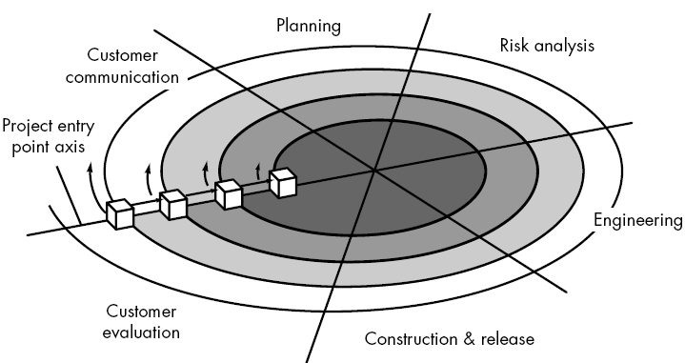
METHODOLOGY
Requirements
i. Functional Requirements
home page(login form)
registration Page
add contacts page
view user profile and contacts
ii. Non-Functional Requirements
fast and accurate
user friendly environment
effective and efficient performance
First Iteration :
- Planning and development of interfaces
Second Iteration :
- Insertion and management of contacts
- Connection of database
Third iteration :
- Integrating system, final testing and maintaining
Figure 1 : Spiral Model

Slide 13
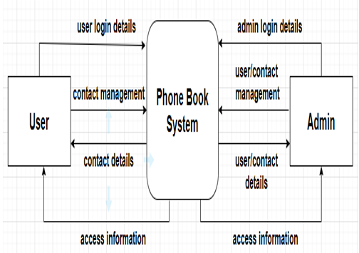
METHODOLOGY
Figure 2 : Zero level DFD of phonebook system

Slide 14
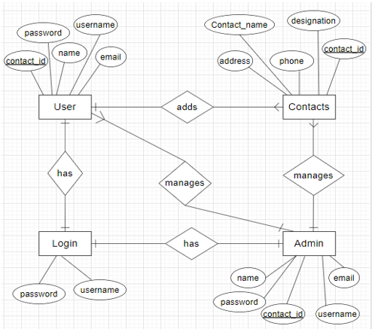
METHODOLOGY
Figure 3 : ER-diagram of Phone Book System

Slide 15
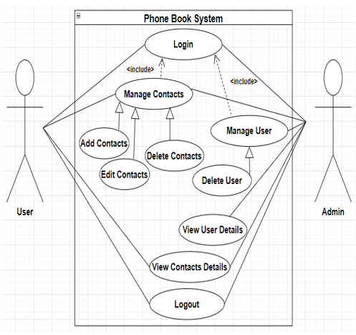
METHODOLOGY
Figure 4: Use Case diagram of Phone Book System

Slide 16
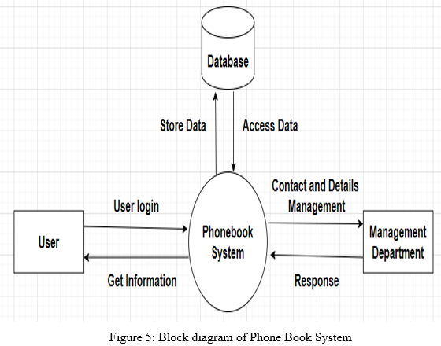
METHODOLOGY

Slide 17
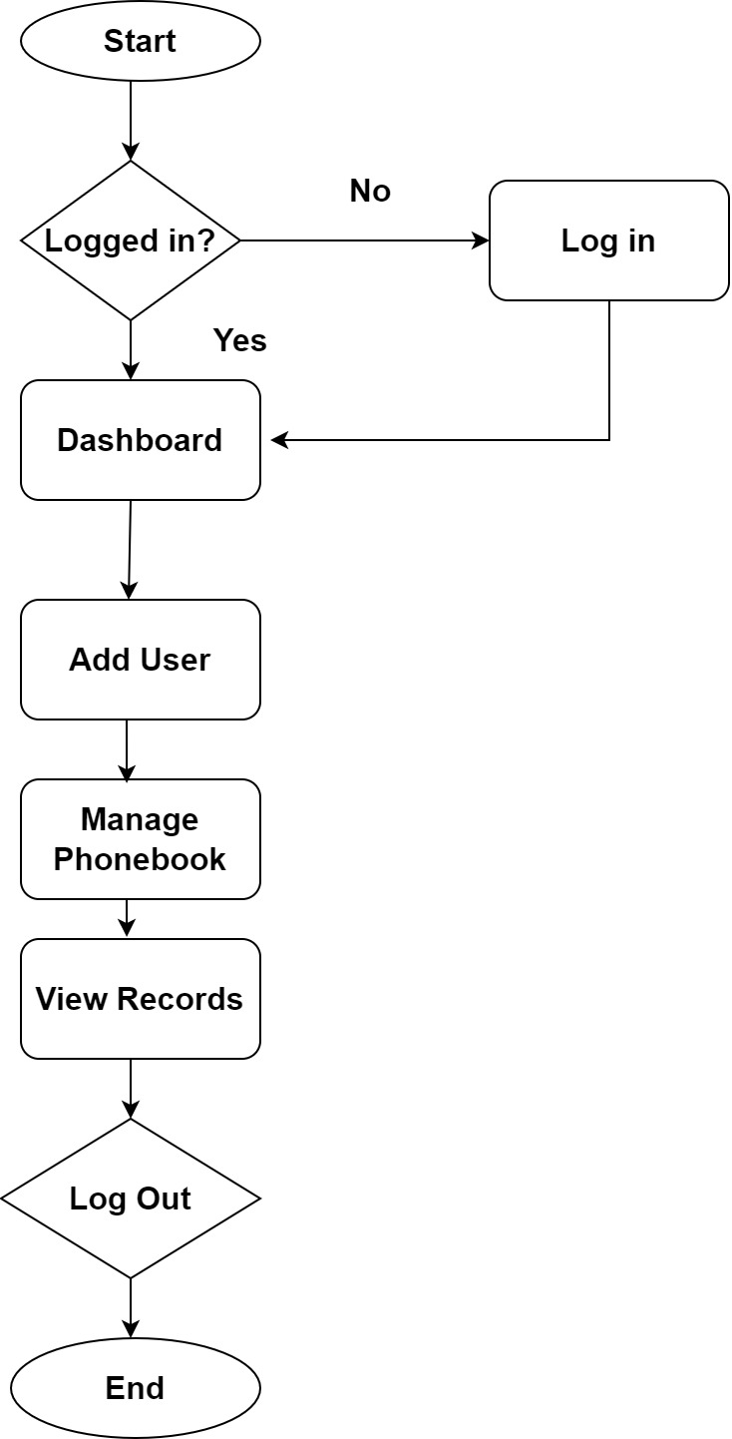
METHODOLOGY
Figure 6: System Flowchart of Phone Book System

Slide 18
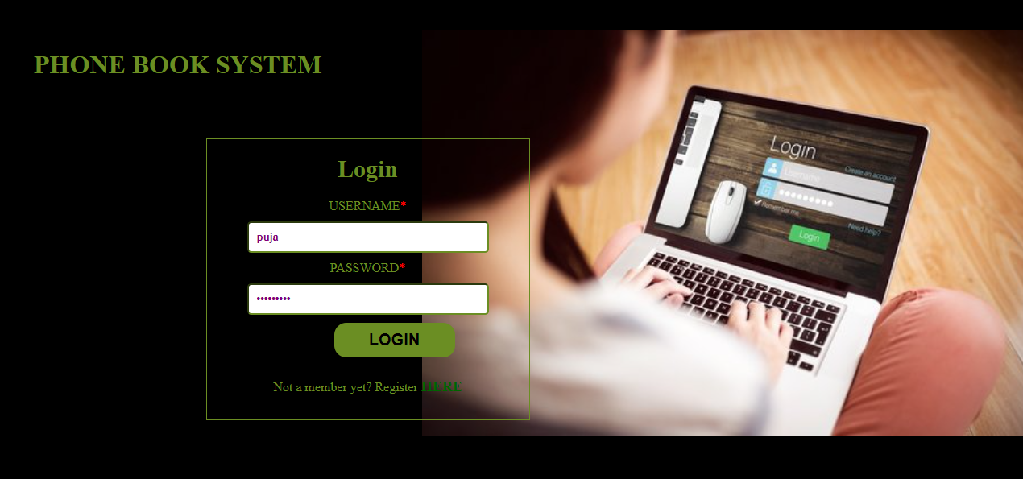
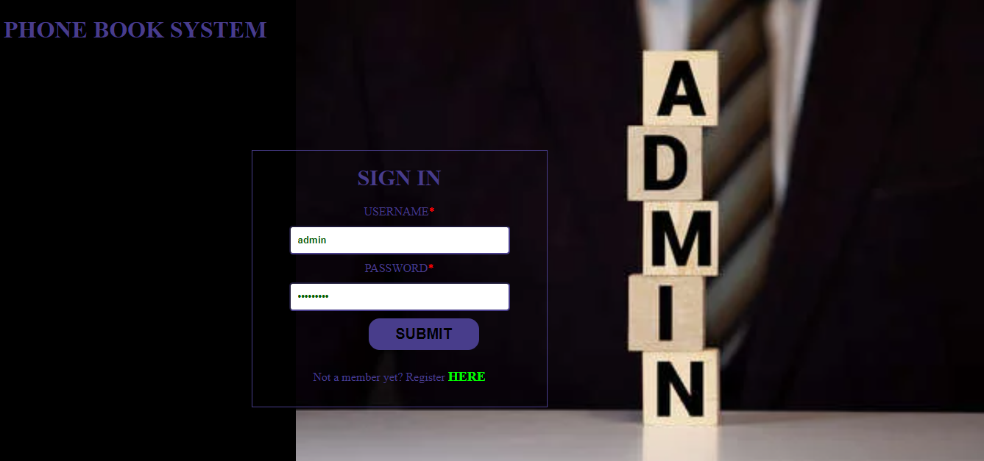
INTERFACE DESIGN
User Home/Login page
Admin Home/Login Page

Slide 19
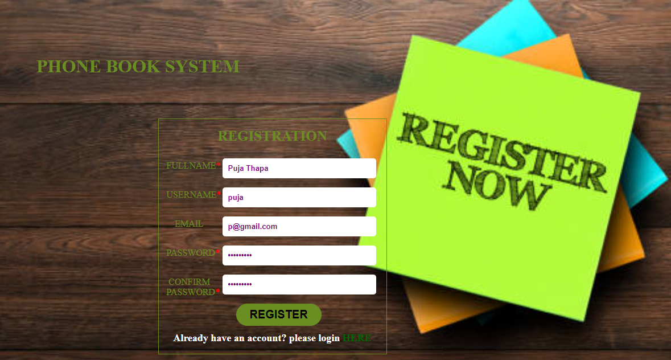
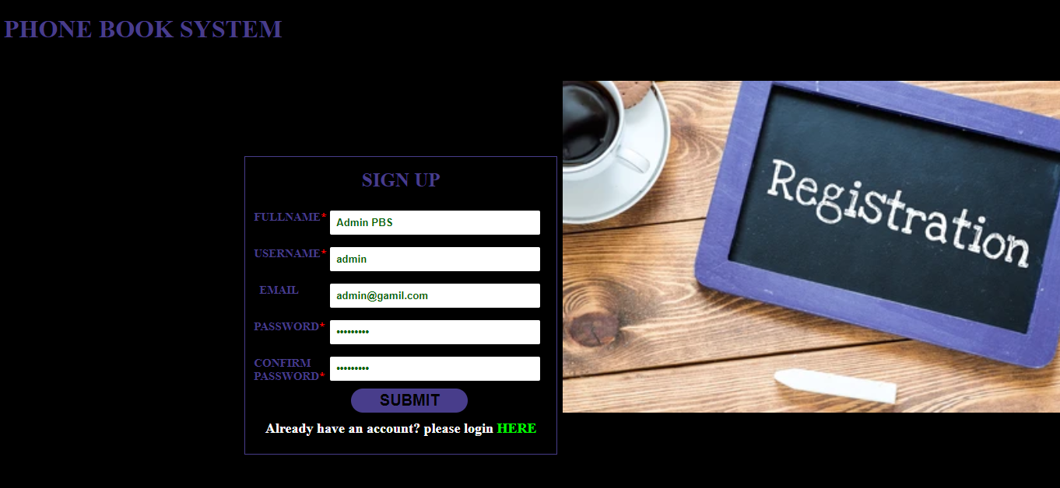
INTERFACE DESIGN
User Registration Form
Admin Registration Form

Slide 20
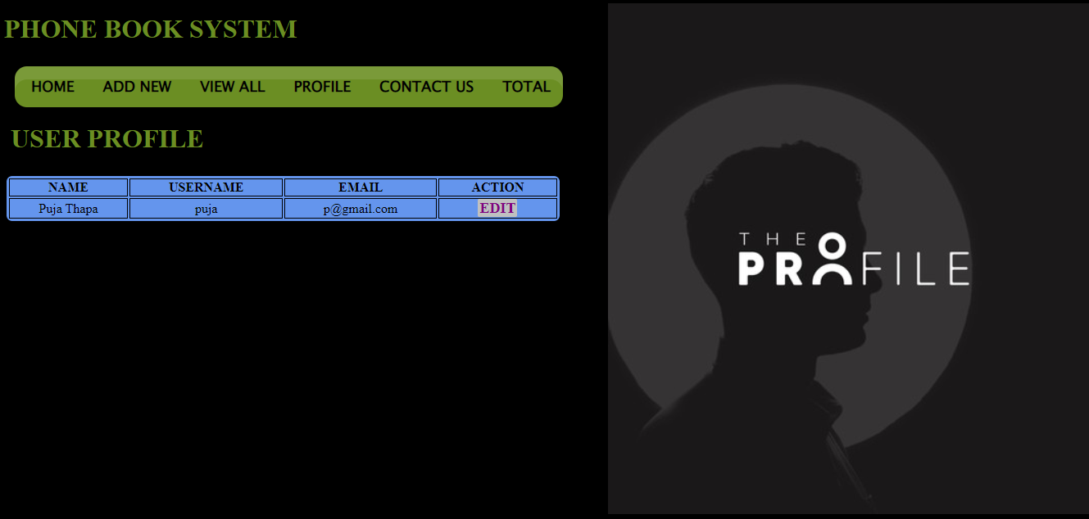
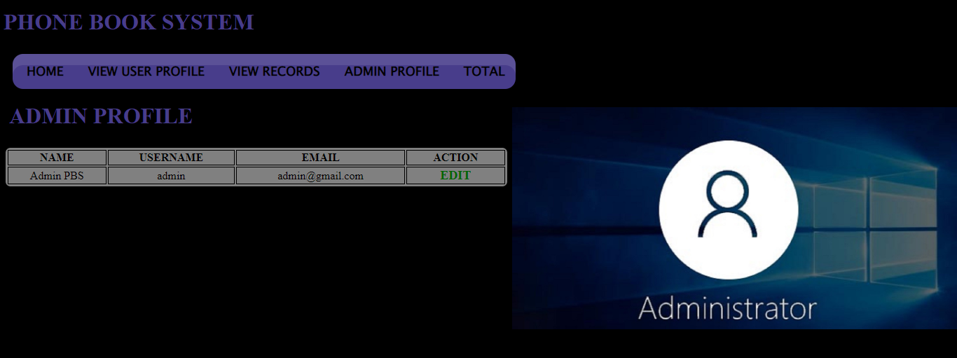
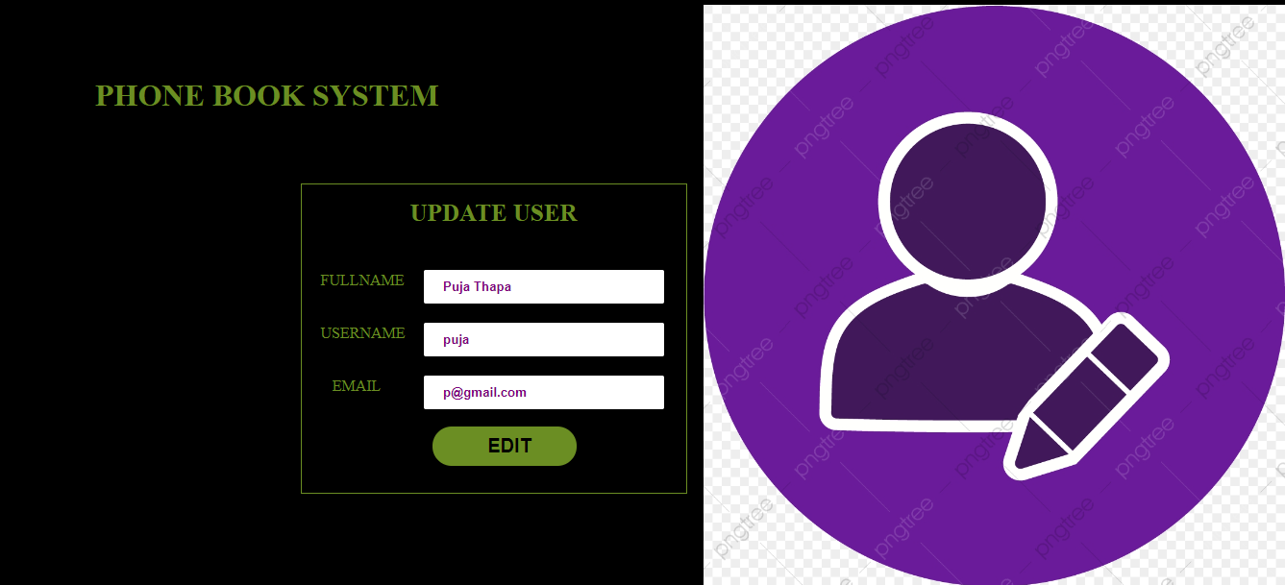
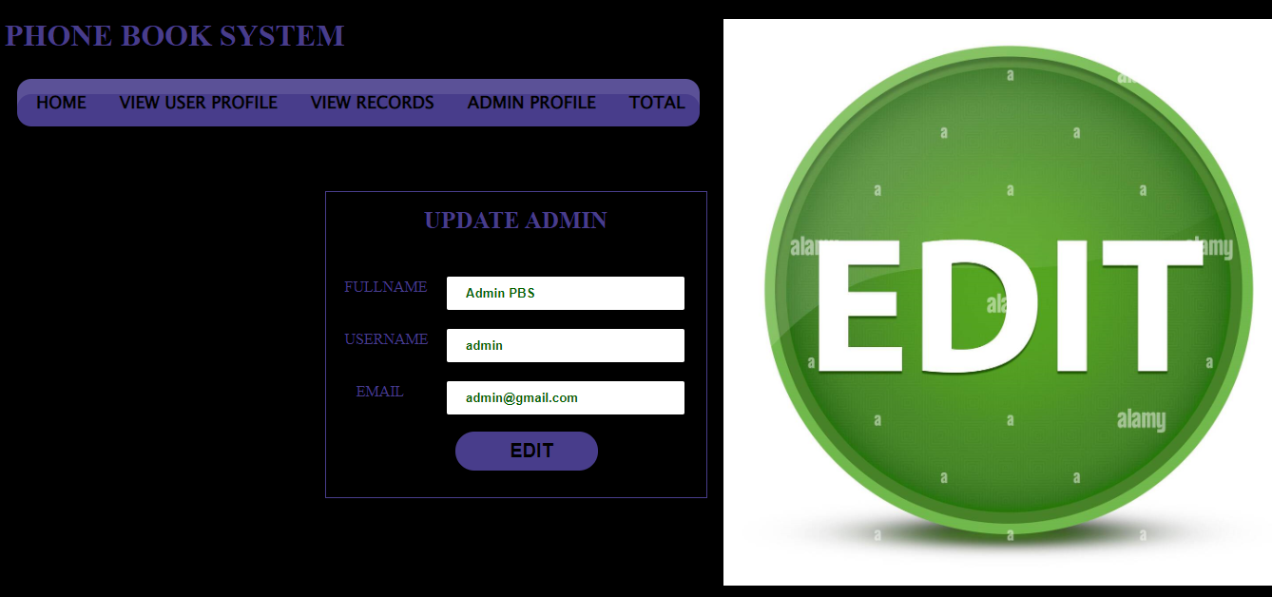
INTERFACE DESIGN
View And Update User profile
View And Update Admin Profile

Slide 21
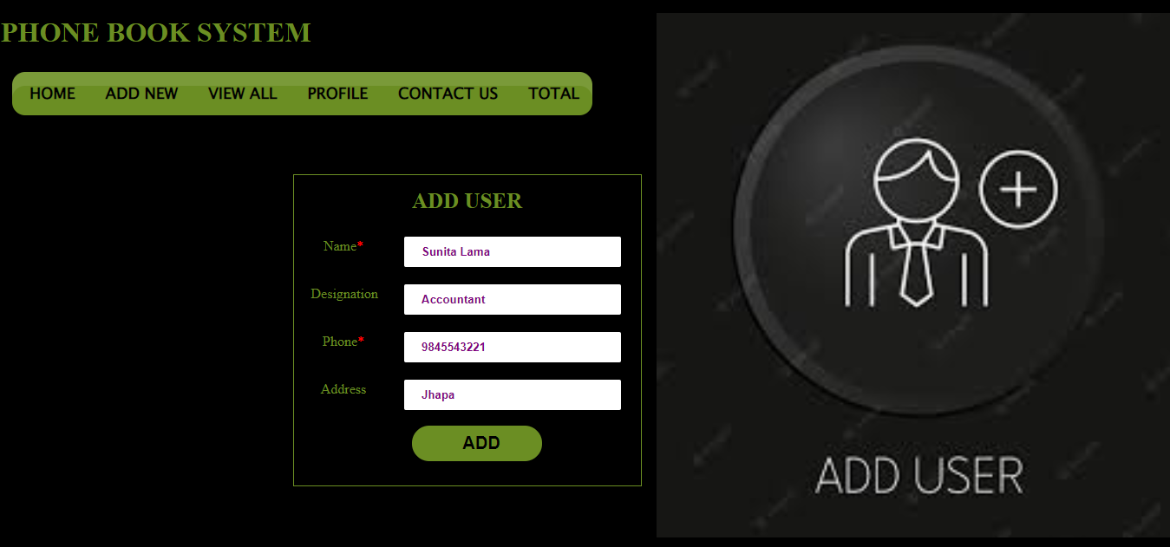
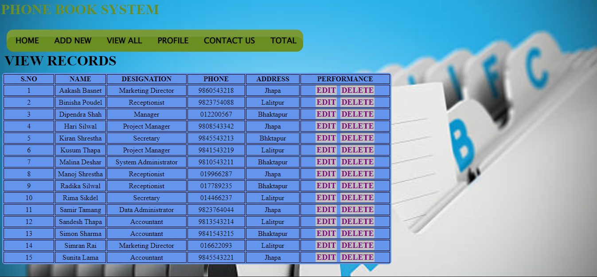
INTERFACE DESIGN
Add Contacts
View Contacts

Slide 22
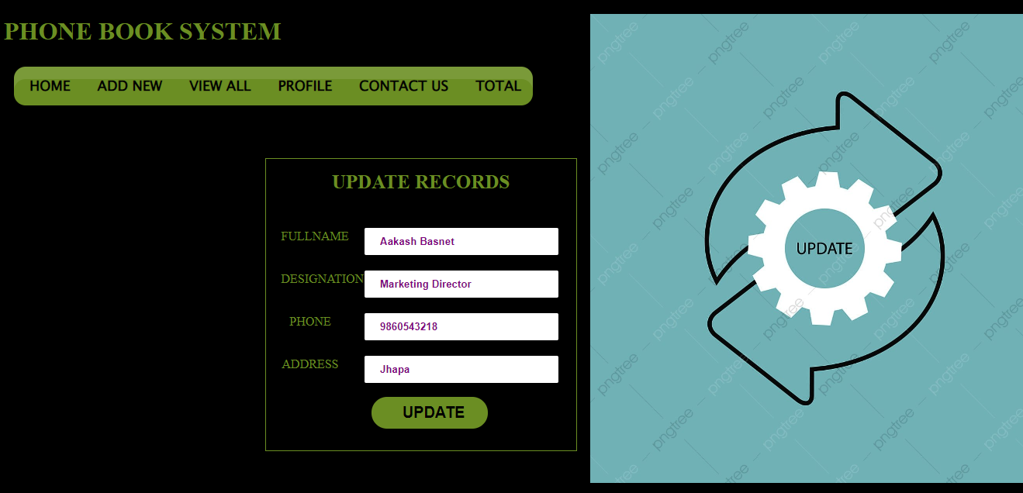
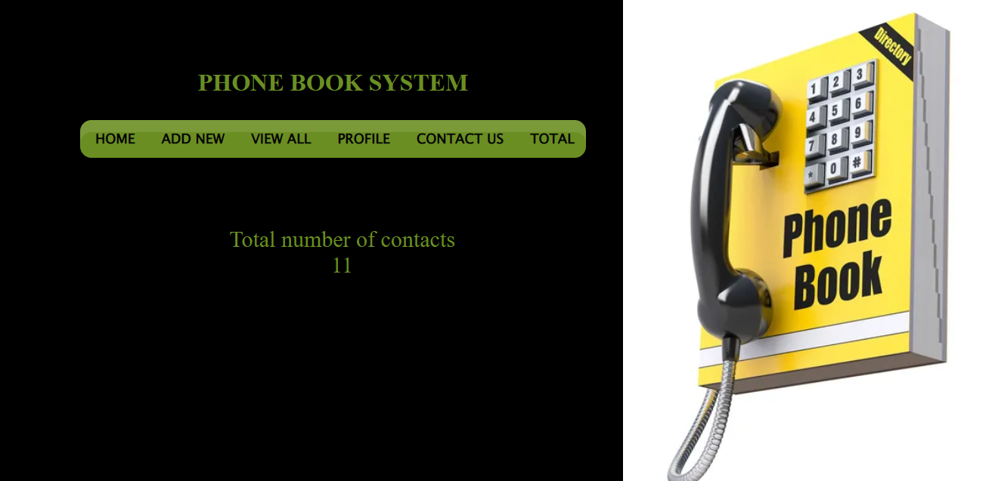
INTERFACE DESIGN
Edit Contacts
Total Number Of Contacts

Slide 23
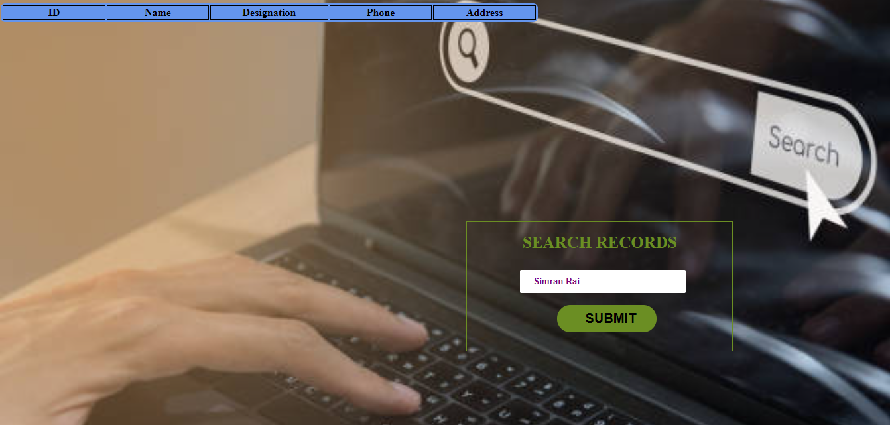
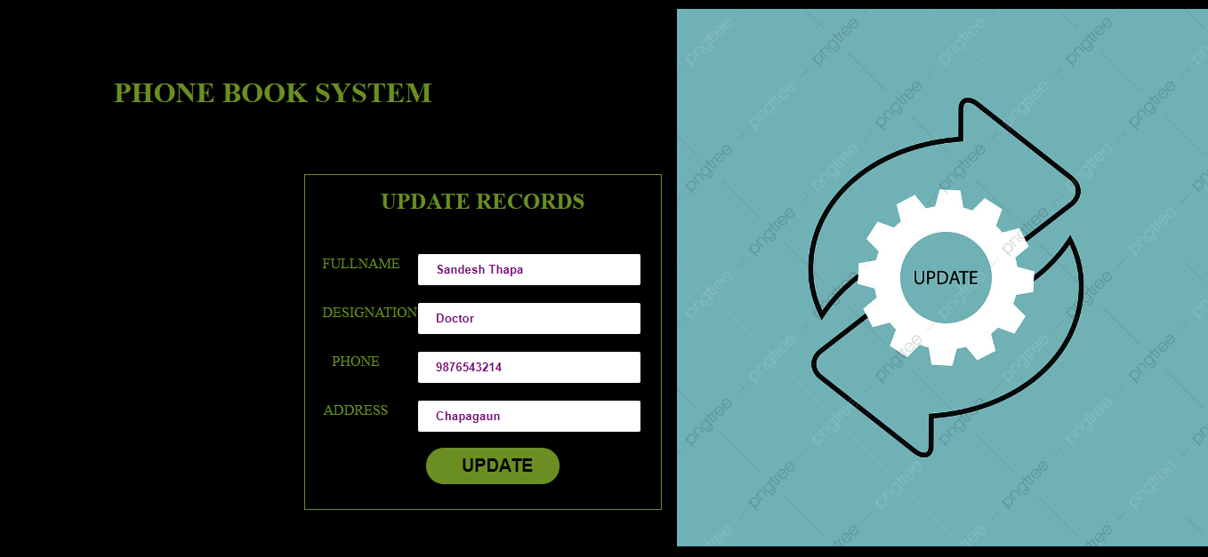
INTERFACE DESIGN
Search Records
Update Records

Slide 24

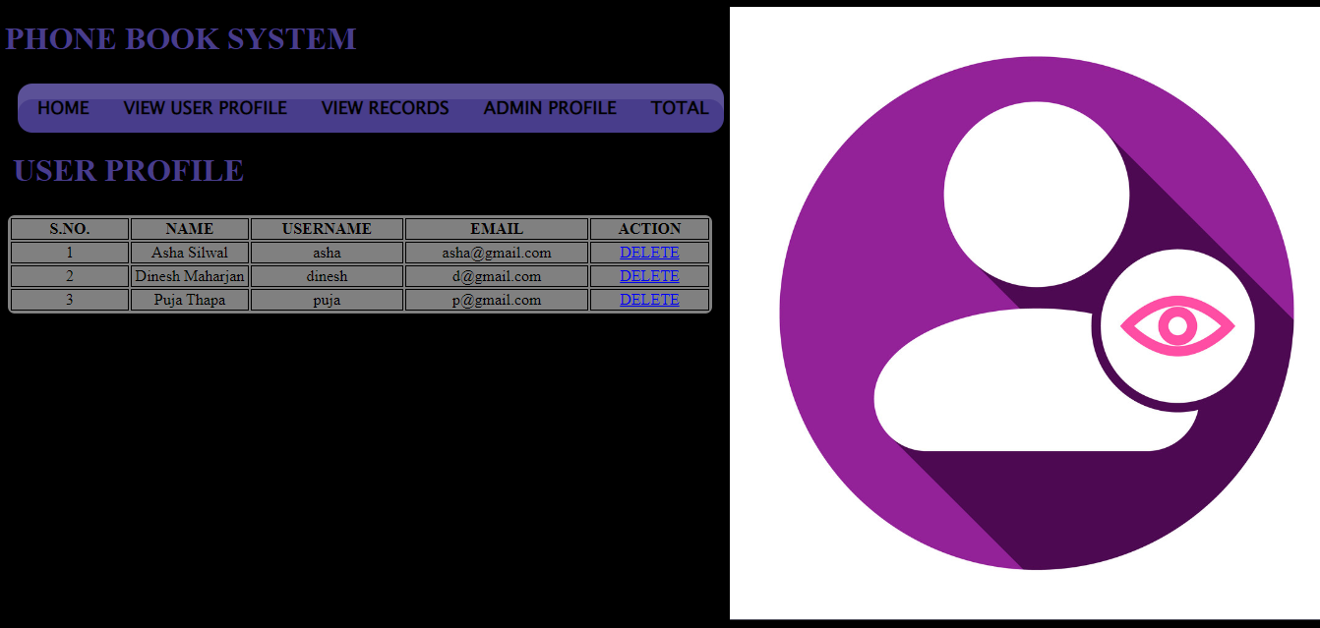
INTERFACE DESIGN
Contact Us View User Profile By Admin

Slide 25
IMPLEMENTATION AND TESTING
Implementation details of module
User Module :
allow to manage menu and system
allow to view, edit, search, delete information
Add User module :
user add new entry of user contacts
i.e. name, address, contact and status
View All Module :
contact information are displayed
allow to edit and delete details

Slide 26
IMPLEMENTATION AND TESTING
Implementation details of module
Admin Module :
allow to manage whole system
allow to view, edit, delete data
Search module :
allow to search contact details
i.e. name, address, contact and status
View User Module :
Allow admin to view users’ information
allow to delete details

Slide 27
IMPLEMENTATION AND TESTING
Unit Test For User
Unit Test For Admin
S.NO | Input | Expected Outcome | Actual Output | Remarks
1. | Add Contacts | Insert into database | Inserted Successfully | Test Success
2. | Edit Contacts | Edit Contacts | Edited Successfully | Test Success
3. | Update User Profile | Update User | Updated Successfully | Test Success
4. | Delete Contacts | Delete Contacts | Deleted Successfully | Test Success
S.NO | Input | Expected Outcome | Actual Output | Remarks
1. | Edit Contacts | Contacts Edited | Edited Successfully | Test Success
2. | Update Admin Profile | Admin Updated | Updated Successfully | Test Success
3. | Delete User | User Deleted | Deleted Successfully | Test Success
4. | Delete Contacts | Contacts Deleted | Deleted Successfully | Test Success

Slide 28
IMPLEMENTATION AND TESTING
System test For User
System test For Admin
S.NO | Input | Expected Output | Actual Output
1. | Username : Puja Password : pppppppppp | Login Successful | Login Successfully
2. | Username : Puja Password : 123456 or Username : Pooja Password : pppppppppp | Login Failed | Login Error
S.NO | Input | Expected Output | Actual Output
1. | Username : admin Password : admin1234 | Login Successful | Login Successfully
2. | Username : aadmin Password : admin1234 or Username : admin Password : admin123456 | Login Failed | Login Error

Slide 29
CONCLUSION AND FUTURE RECOMMENDATION
Goals achieved by this project are :
Management of information efficiently
Less processing time
Getting required information easily
Optimum utilization of resources
Simplify the operations

Slide 30
CONCLUSION AND FUTURE RECOMMENDATION
Future Enhancement
Improved security using emerging technologies
GPS can be added

Slide 31
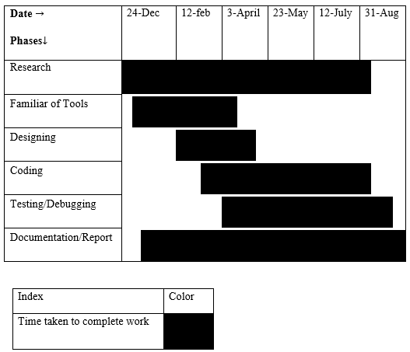
WORK SCHEDULE
Gantt Chart

Slide 32
REFERENCES
Singh Saud Ramesh, Chaudhary Indra, 2076 “DATABASE MANAGEMENT SYSTEM”, KEC publication and distribution pvt.ltd
Singh Saud Ramesh, Singh Saud Bhupendra, Chaudhary Indra, 2076 “SYSTEM ANALYSIS AND DESIGN”, Kathmandu, KEC publication and distribution pvt.ltd
Schmidt, A., & Gellersen, T.S.(2001) “Telephone Directory System” Germany.
Bentley F, & Chen, “Phone Book Application”, Tamil Nadu: VITBS(VIT University Vellore).
Doran, A., & Jeffrey, R.(2013) ”Phone Book System” Australia: Harvard University.
Using real time computer vision algorithms in automatic attendance management systems by V Shehu, A Dika - (ITI), 2010 32nd International Conference on, 2010
Published in: Computer Science and Information Technology - Spring Conference, 2009. IACSITSC '09. International Association of. Date of Conference: 17-20 April 2009 Page(s):174 - 177 Print ISBN: 978-0-7695- 3653-8

Slide 33
THANK YOU

